Slide 1
Building Bridges - The Role of Training & Employment for Successful Reentry of the Justice Involved
Andrea Snow, Senior Vice President, Ancora
Micaela Pearson, Chief Business Officer Career EDGE, LLC
Notes:
Add note to this slide

Slide 2
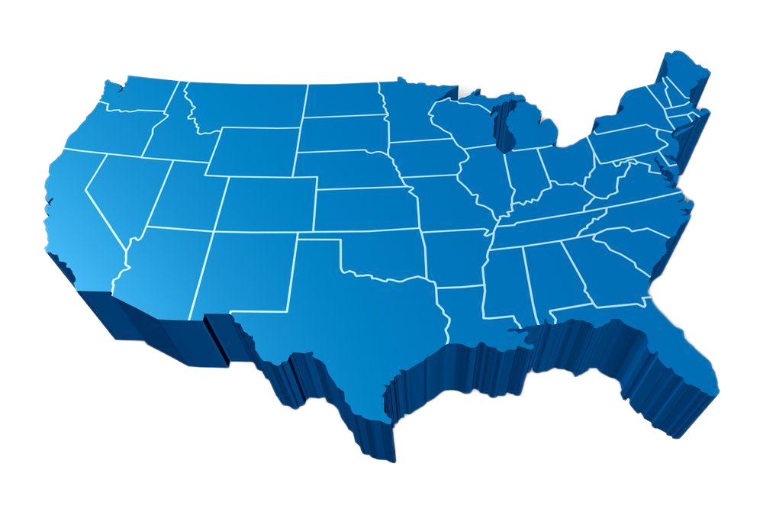
National Scale
Ancora's comprehensive educational approach aims to empower students to excel in their chosen careers.
It strategically combines online platforms, physical campuses, and training locations across the nation, enabling students to overcome barriers and engage in immersive learning experiences.
Through this approach, students acquire academic knowledge, practical skills, and real-world exposure necessary to thrive in their future endeavors.
Ancora Training
Ancora Schools

Slide 3
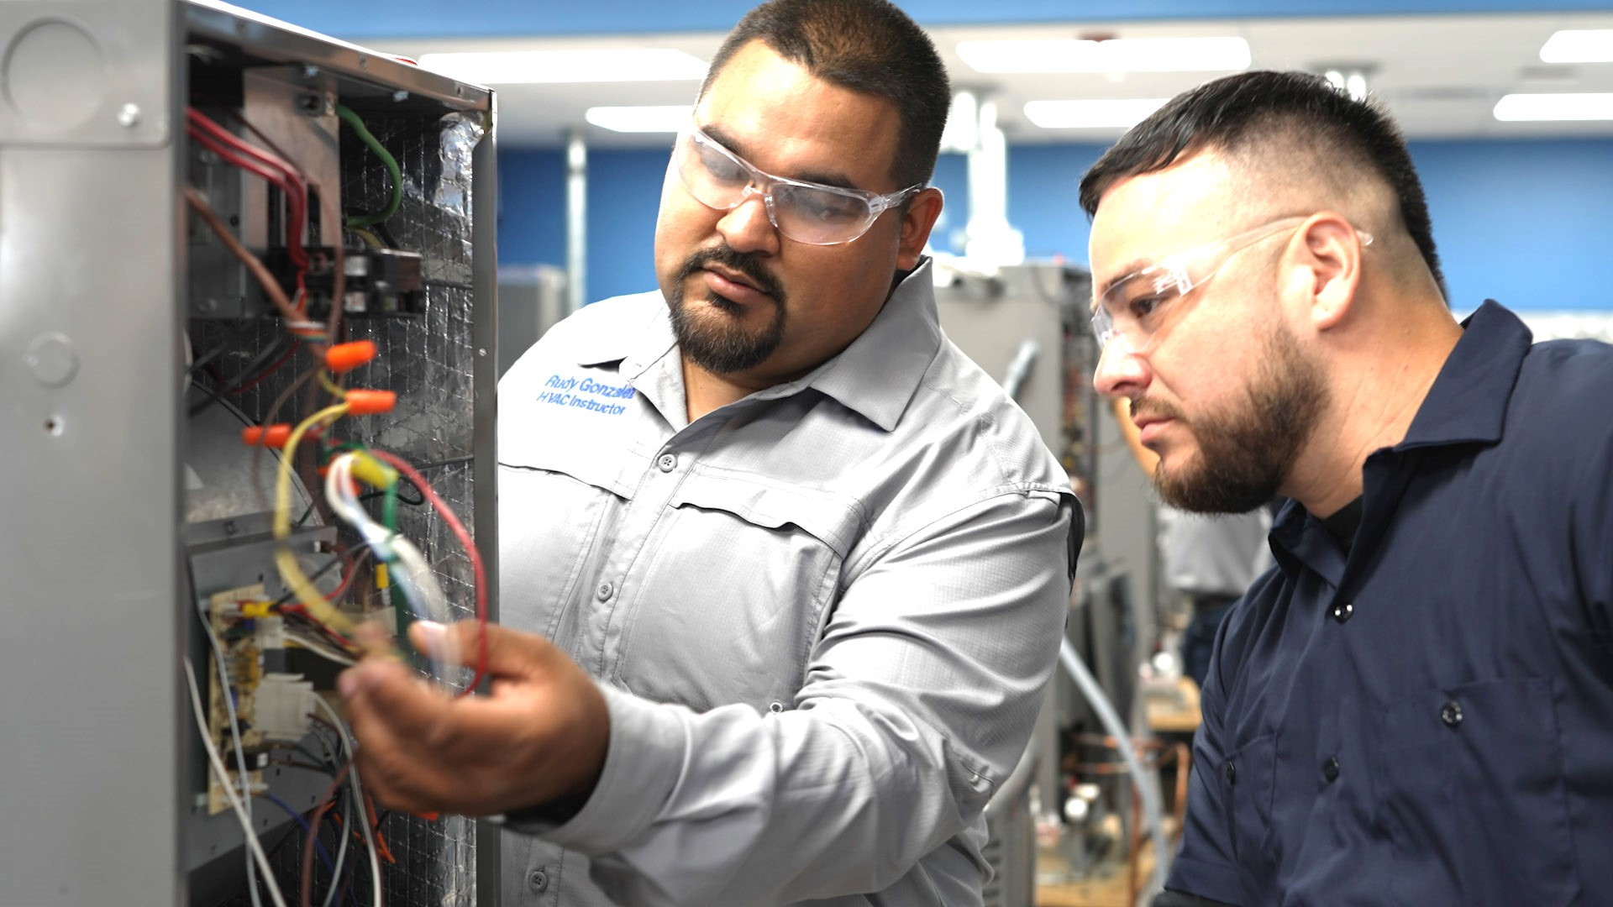
Our four business verticals offer programs that have been serving students through technical, skills-based training since 2013. Ancora has become an industry leader in education and now trains over 25,000 students annually.
Traditional Post-Secondary
Campus and Online
B2B, B2G, B2E
Online, Short-Cycle Asynchronous
Non-Traditional Secondary Education
Notes:
Add note to this slide

Slide 4
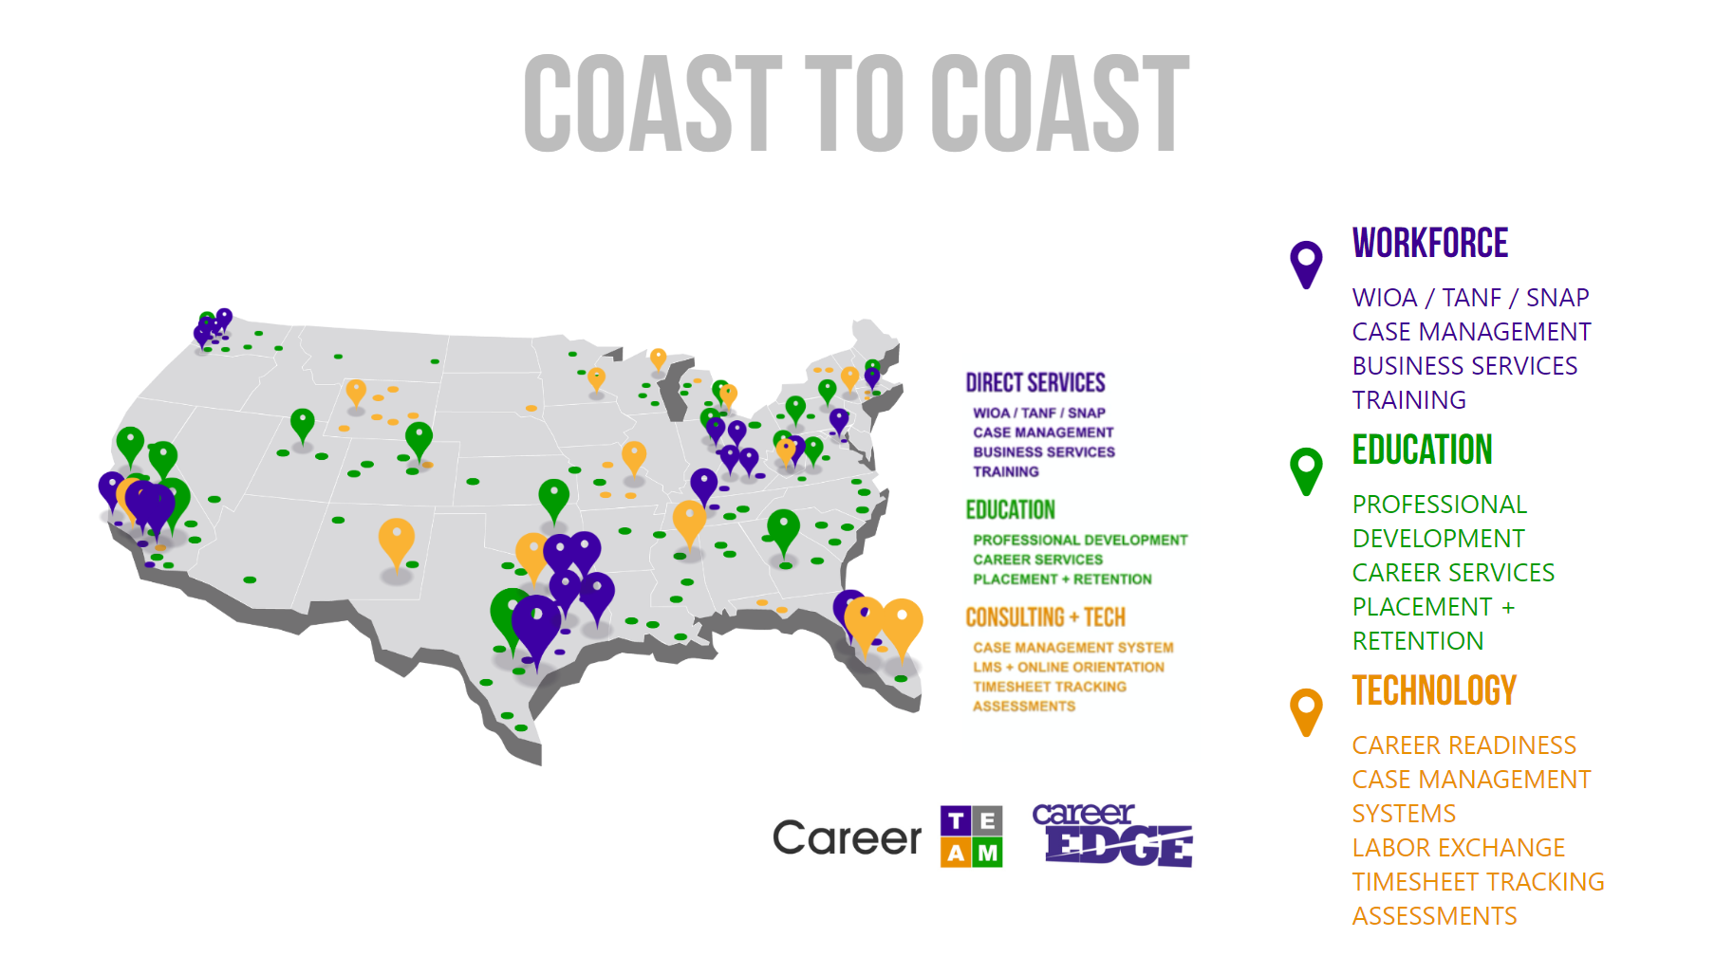

Slide 5
AREAS OF FOCUS
Ancora offers access to a broad range of disciplines, including:
TRANSPORTATION
SKILLED TRADES
ALLIED HEALTH
BUSINESS & IT
Providing CDL training (Class A and B)
Including Electrical Technician, HVAC Technician, Maintenance, and Combination Welding
Healthcare-focused disciplines such as Medical Assisting and Pharmacy Tech
Fields include Cyber Security, IT Support, Business Admin, Marketing, and HR
Notes:
Add note to this slide

Slide 6
Reentry Defined

Slide 7
Reentry Defined
Reentry in criminal justice is the process of helping people transition from prison or jail back into the community. It involves preparing for release and addressing the challenges of reintegrating into society

Slide 8
Why Reentry matters?
95% of incarcerated citizens will be released in their lifetime
For every dollar invested in education, tax payers see $4 - $5 savings in housing justice impacted residents
75% of incarcerated individuals in the U.S. do not possess a high school diploma or GED, severely limiting their ability for education and training in traditional academia

Slide 9
Reentry Trends & Initiatives
Organization
Trends/Reentry 2030
IT Infrastructure

Slide 10
Organization of the Justice System
DOC
Education versus Reentry
Private Prisons
Parole
Juvenile Justice
Workforce & Education
Reentry focused non-profits

Slide 11
ReEntry 2030
ReEntry 2030 (AL, MO, NE, NC)
Human Centered
Coordinated
Transparent
Equitable

Slide 12
REENTRY 2023
Successful reintegration for every person.
100%
85%
of incarcerated Missourians who need Career Services, recieve them.
80%
of incarcerated Missourians are employed within 30 days of release.
of formerly incarcerated Missourians maintain their employment for at least nine months after release.

Slide 13
food &
Water
Clothing
Transportation
Support
network
Education
Employment
Technology
Health
needs
Behavioral
health needs
Housing

Slide 14
IT Infrastructure
Pre-release programming historically prohibited use of technology
More states are allowing use of tablets, chrome boxes and other devices that meet security standards
This opens opportunities for hybrid and distance learning

Slide 15
Configuration Options
User Login Experience
Security Configuration
Job Seeker Status
Email + Password
Email + Randomized Security Question & Answer
User ID + Password
User ID + Randomized Security Question & Answer
Video Hosting
Document Downloading
Document Emailing
Audio Recording
Video Recording
Applying Directly to Jobs
Released
Resident

Slide 16
COMMON IMPLEMENTATION FOR
REENTRY PROGRAMS
Email & Password
User ID & Security Questions
Work Readiness Modules
Toolkit
Email & Download Documents
Record Audio/VIdeo
Job Board
Apply Directly to a Job
Default Software Experience
Client (Released) Experience
Resident Experience

Slide 18
Examples in Action
Ancora High School
Transitioning
Actively Incarcerated
Ancora Training

Slide 20
Questions?
Andrea Snow
Ancora
andrea@ancora.com
Micaela Pearson
Career TEAM
micaela@careerteam.com

